Slide 1
PREVENTING DISEASE WITH OPTIMAL HEALTH & WELLNESS
Elizabeth Burmeister
Health Promotions Coordinator
Elizabeth.a.burmeister.civ@mail.mil

Slide 2
Pillars of Optimal Health
Nutrition
Physical Fitness
Stress Management
Tobacco Cessation
Supplement Safety

Slide 3
Firefighter Health
82.5% US Firefighters overweight or obese
Increased risk of job-related disabilities
Poor exercise tolerance
Increased CVD
70% of chronic medical conditions can be prevented with diet, exercise and healthy lifestyle

Slide 4
Bring the Basics Back to Nutrition
Stick with whole foods, avoid the processed foods
½ plate at every meal should contain vegetables & fruits
Stick with lean PRO at every meal (chicken, turkey, fish)
Focus on complex CHO (WG/WW, oatmeal, sweet potatoes, brown rice, etc)
Stick with healthy fats (nuts/seeds, avocado, extra virgin olive oils)
Don’t skip meals!
Hydrate! Hydrate! HYDRATE!!!
Drink ½ your body weight in oz of water/day
Consume more if hot weather, sweating excessively or exercising
Avoid too much caffeine/energy drinks/alcohol

Slide 5
Macronutrient Goals
Recommended Ranges (% of calories)
Variable depending on goal
Gains: 40-60% CHO, 25-35 PRO, 15-25% FAT
Maintain: 30-50% CHO, 25-35% PRO, 25-35% FAT
Loss: 10-30% CHO, 40-50% PRO, 30-40% FAT
Variable depending on type of exercise
PRO
Endurance: 1.2g/kg body weight
Strength: 1.5-2g/kg body weight
CHO
7-10g/kg body weight

Slide 6
Commissary Shopping
Nutrition Guide Program (NGP)- align the criteria for tagging grocery items as closely as possible with Go4Green (G4G)
DeCA’s five nutrition attributes:
Whole Grain
Good Source of Fiber
Low Sodium
Low Fat
No Sugar Added
Additional label elements
USDA Certified Organic
Notes:
Speaker: When shopping at the Commissary, look for the NGP logo on food items to ensure you are buying healthier options. The NGP includes: Packaged good items, and dairy products that have a thumbs up symbol have been approved as meeting criteria by DoD and service dietitians as being of high nutritional quality. They are nutrient dense and are a great choice in building a healthy eating pattern to promote optimal health and performance. These items align with the criteria for Go for Green and the Dietary Guidelines for Americans. Think of the thumb as, “Dietitian Approved! We did the work for you”. Building a healthy meal pattern to promote performance begins with building a nutritious cart!
Aim to:
Fill your cart with mostly with
Fresh produce
Lean meats and eggs
Heart healthy fats from fish, nuts and seeds, olive and canola oil and avocados, etc.
Packaged items that have the Thumbs-Up
AND
Remember:
It is okay to include a few indulgences and treats. Just use the nutrition attributes to guide you.

Slide 7

Nutrition Guide Program (NGP)
NGP is a credible, dietitian approved intervention that aims to improve dietary choices and the overall quality of the diet of the military community.
point of sale information system that highlights key nutrient attributes of store products.
consists of five nutrient attributes and one lifestyle attribute
deployed worldwide in the January 2017.
Notes:
Speaker: Bullet 1: The commissary is an integral part of the installation that is used by service members and their families throughout the course of their military career and beyond retirement—as such DeCA plays a major role in influencing the health and wellness of the military community—and is truly a key asset in supporting the mission of readiness and resilience.
DeCA worked in partnership with DoD activities and Service branch health and wellness leads to align the NGP as closely as possible to the DoD’s “Go For Green” program that is deployed in military dining facilities to guide service members in making food choices that promote optimal health and performance.
Sub Bullet 1- Nothing
Sub Bullet 2-The program is consists of five nutrient attributes and one lifestyle attribute: Low sodium, No added sugar, Low-fat, Whole grain, Good source of fiber, Certified Organic (lifestyle)
Qualification for the attributes is based on Food and Drug Administration (FDA) and United States Department of Agriculture (USDA) criteria.
NGP items with the “Thumbs up” icon align closely with the Green category in the “Go for Green” Program- which means the items are nutrient dense, high performance foods.
Items that qualify for an attribute(s) but do not meet the criteria for a “Thumbs up” icon will still have a label that displays the nutrient attribute(s).
Sub Bullet 3- Store signage and educational material that guides patrons on how to use se of the NGP to build a healthy shopping basket will be available at the store and is also posted commissaries.com under the Healthy Living section.

Slide 8
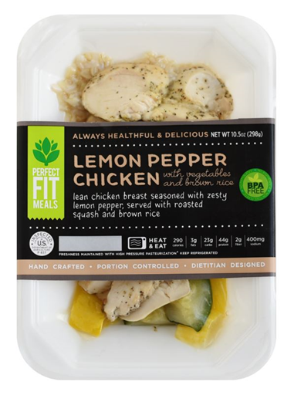
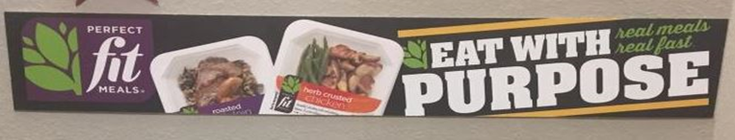
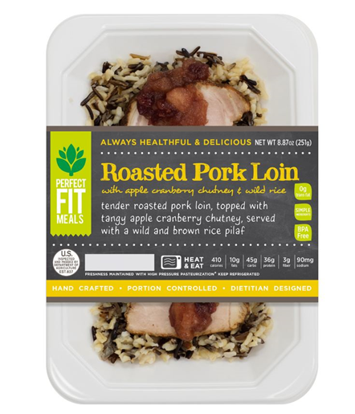
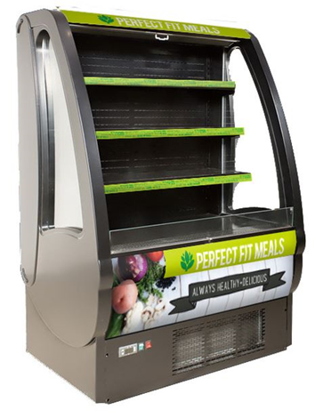
Perfect Fit Meals
Dietitian Prepared
Microwavable Meals
Notes:
Speaker: Airmen should also look for the “Perfect Fit Meals” available at their commissary which are also dietitian prepared and microwavable. These meals would be a great option for airmen that reside in dormitories.

Slide 9
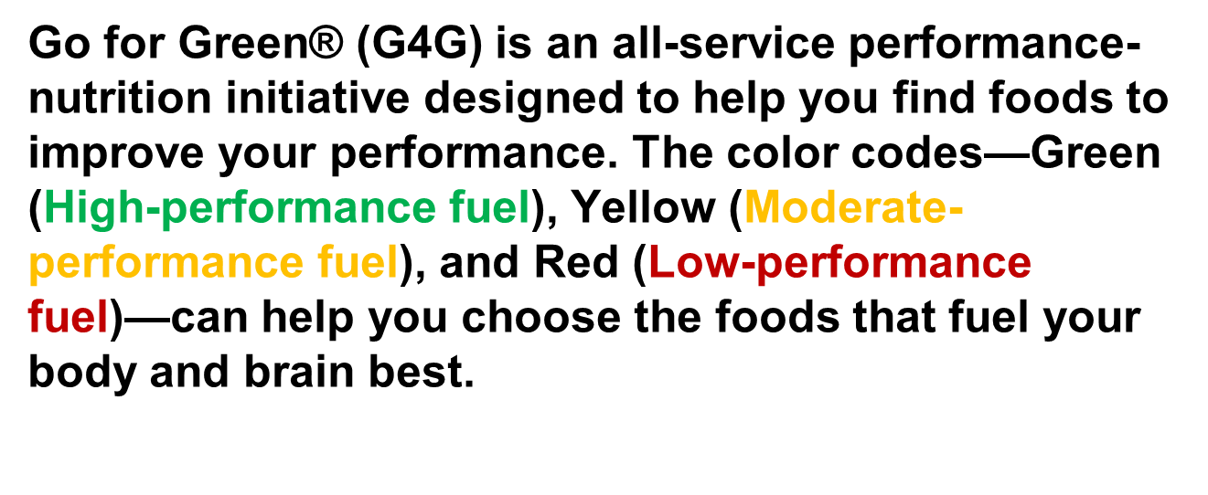


Eating at the Dining Facility
Notes:
Speaker: When eating at your Dining Facility (DFAC), use the Go for Green as a guide to help you choose nutritious food to improve your performance.
https://www.hprc-online.org/sites/default/files/G4G%20Guide%20101515_508.pdf
Green-coded foods are whole foods that are naturally packed with nutrients such as vitamins, minerals, fiber, protein and "good”, eat these items often
Yellow-coded items are the more-processed foods, choose your portions carefully and eat these items occasionally
Red-coded items are the most processed and have the least amount of nutrients, choose small portions and eat these items rarely

Slide 10
Snack Ideas
Fruit- fresh or pre-packaged. Try adding yogurt, rolled oats or nuts/seeds.
Wholegrain crackers with a tin of tuna or baked beans
Natural nut mix or air popped popcorn
Vegetable sticks with dip (e.g., avocado, hummus)
Fruit toast or homemade vegetable/fruit muffin
Smoothie or bowl of breakfast cereal
Notes:
Speaker:
Pack your own healthy snacks. It can be difficult to find healthy snacks during the afternoon and night shifts. The dining facility may be closed. Vending machines may only carry salty or high fat snacks, and high calorie sugary drinks. This slide list some snack ideas
Source:
Workplace Health and Safety Queensland. 2015. “Shifting Nutrition: A shift workers guide to nutrition.” worksafe.qld.gov.au.

Slide 11
Plan Ahead
Plan your meals, grocery shop and meal prep
Try buying:
Zip lock bags and small reusable containers
Frozen mixed veggies or individual steamed bags
Pre-packaged fresh vegetable and salad mix bags
Tins of tuna, chicken or baked beans
Frozen microwave steam fresh fish
Single serving of rice, quinoa or pasta packets
Single serve tubs of soup
Ready to eat frozen or fresh meals
Notes:
Speaker:
Being organized is the key to eating well on shift. Set yourself up for success by planning your meals for the shifts ahead, going grocery shopping and completing some meal prep.
Source:
Workplace Health and Safety Queensland. 2015. “Shifting Nutrition: A shift workers guide to nutrition.” worksafe.qld.gov.au.

Slide 12
Eating Before Exercise
Consume Carb-rich meal or snack to increase energy availability and speed post-exercise recovery
Include small amounts of PRO in pre-game meal to help reduce post-exercise muscle soreness
Choose foods low in fat and fiber to ensure optimal tolerance
Prevent dehydration by replenishing fluids hours leading up to exercise
Pre-Exercise Foods & Fluids
1-4HRS prior
Peanut butter and hone on bread + fruit and yogurt smoothie
Oatmeal with brown sugar and almonds + banana
Low-fat cottage cheese or yogurt + granola + fruit
Lean hamburger or chicken + side salad + fruit & yogurt parfait
Turkey and swiss sandwich + fruit
30-60min prior
Piece of fruit, crackers or jam sandwich
Sports drink or water

Slide 13
Eating for Recovery
Replace fuel (CHO) utilized by muscles during exercise by consuming snack/meal within an hour post training or competition
Restore Fluid and electrolytes lost through sweat
Eat 12-25g of high-quality PRO to aid in repair and rebuilding of muscle tissue
Recovery Fluids & Snacks
Smoothie with LF mild + spinach or kale + frozen fruit
Graham crackers with PB + LF chocolate milk + banana
Sports drink + sports bar
WW pita chips + hummus + 100% juice
Dried Fruit and trail mix + water
Recovery Meal Ideas
Sandwich wrap w/ turkey & spinach + fruit bowl + LF milk
Rice bowl w/ beans, cheese, salsa, avocado + WG tortilla chips or WW tortilla
Grilled PRO + broccoli, bell peppers, carrots + roasted sweet potatoes
Stir-fried tofu & veggies + quinoa + bowl of soup
Veggie omelet + WW toast + apple slices

Slide 14
Physical Fitness
If Sedentary lifestyle get up and do SOMETHING
Going from no exercise to just a little puts good stress on muscles
Establish your own baseline and work up from there
Make it challenging but not impossible
Utilize FITT principle to prevent “plateau”
Focus on Functional Fitness depending on environment
Firefighters: HIIT, Plyometrics, Circuit, Endurance, Sprints
Stretch Stretch STRETCH!!!
Improves flexibility/balance, decreases risk of injury, contributes to muscle recovery and repair
Improves not only physical wellness but mental wellness (cognitive function, memory, learning)

Slide 15
Sleep Hygiene
Focus on getting 7-9hrs of sleep/night
Minimize sleep debt (need to make up for lost sleep), naps (15-30min)
Improves cognitive function, decrease risk of depression/anxiety, weight loss, better immune system, energy boost, important for recovery
Good Practices
Avoid caffeine 6hrs/prior to going to bed, alcohol/tobacco prior to bed
Avoid electronics 1-2hrs prior to bed
Make room comfortable, quiet, cool & dark
Establish routine (hot bath/shower, read a book, guided meditation, deep breathing)

Slide 16
Stress Good & Bad
Can be motivational to achieve goals
Constant demands of job/personal life/physically leads to stress overload
Burnout, impaired task performance, increase risk of injury/illness/depression/anxiety
2 most stressful jobs in US based on 2016 stats
#1: enlisted military personnel
#2: firefighter
Decompress
Deep breathing exercises, yoga, guided meditation, “heart-focused breathing”
Good quality (7-9hrs) sleep
Exercise, good nutrition
DO NOT TOUGH IT OUT!! Use resources

Slide 17

Operation Supplement Safety A DoD-wide Educational Initiative
From the Human Performance Resource Center (HPRC)
Notes:
Increase awareness among active-duty service members about dietary supplements
Provide tools to be “smart” supplement users

Slide 18
Dietary Supplement Basics
A dietary supplement is:
a vitamin
a mineral
an herb or other botanical
an amino acid
a dietary substance for use by man to supplement the diet by increasing the total dietary intake
or a concentrate, a metabolite, a constituent, or an extract
FDA has no comprehensive list of supplements on the market
FDA responsible for post market surveillance
-monitoring adverse event reports and consumer complaints*
- Internet search for supplements that do not comply with regulations
- Conducting onsite inspections of manufacturers’ facilities
-Limited surveillance of supplements sold on the Internet
Some claims supported by unreliable sources
Notes:
one company submitted a 30-year-old handwritten college term paper to substantiate its structure/function claim, while others included articles from trade newsletters; press releases; advertisements; and links to Web pages, such as Wikipedia or an online dictionary

Slide 19
Key Messages
Food first because supplements:
Choose wisely: Get the facts first!
Know how to spot red flags
Know what to look for on a label
are not as complete as food
can be more expensive than food
can be dangerous
are not FDA-tested or -approved before marketing
Notes:
Dietary supplement users need to be reminded that FOOD is the most efficient fuel for the body because FOOD provides additional nutrients in combinations that are not readily found in supplements.
In addition, dietary supplements are generally more expensive than food.
For example, two baked or grilled chicken breasts with the skin removed provide at least 50 grams of complete protein. And not only protein…chicken also supplies many essential vitamins and minerals at a fraction of the cost of a protein supplement. And if the chicken comes from a base dining facility, the cost savings are even greater.
Many who use dietary supplements believe the products are safe because they were purchased on base or via the Internet. The truth is that dietary supplements are NOT approved by the U.S. Food and Drug Administration (FDA) prior to being sold.
FDA will review a dietary supplement only after receiving reports about harm caused by the supplement.
It is the responsibility of the dietary supplement manufacturers to ensure safety.
So how can a dietary supplement user be smart about the products he or she uses?
An important first step is to check the Operation Supplement Safety (OPSS) Red Flags InfoSheet for how to identify and avoid potential problems.
Another important step is to read the Supplement Facts panel required on all dietary supplement products.
Be cautious of “proprietary blends” listed on a Supplement Facts label; the label does not have to state the amount of each active ingredient in the product.
So the user may be wasting money if he/she paid for a product that actually contains only a fraction of the ingredient desired.
The take-away message is simply this: CHOOSE DIETARY SUPPLEMENTS WISELY.

Slide 20

Is it Safe?
Check for:
No ingredients listed as “blends”, “proprietary blends,” or “delivery systems”
All ingredients have DVs* less than 200%
No caffeine or caffeine limited to <200 mg/serving/day
Third-party certified/verified
Notes:
* DV = Daily Value, the recommended daily amount of a particular nutrient
% is usually based on a 2,000 calorie diet
There are additional tools to help dietary supplement users make wise choices.
The OPSS High Risk card provides a checklist to use when reviewing a Supplement Facts label.
Answering the questions on the card provides a quick check for potential safety to help the user make an informed decision.
Some of the questions here are taken from the card.
Another important safety check involves third-party certification/verification.
Check each dietary supplement for at least one of the seals shown on this slide.
These organizations certify that a dietary supplement has been evaluated for manufacturing practices, purity, and/or quality.
This means that the Supplement Facts label accurately reflects the ingredients in the supplement (for the particular lot tested).
The percent Daily Value—noted in the second bullet here—is a guide to the nutrients in one serving of a food.
For example, if the label lists 15% DV for calcium, it means that one serving of the supplement provides 15% of the calcium needed each day.
The % DV can thus help determine if an item is high or low in a specific nutrient.
Supplements that contain more than 200% DV for any nutrient should be avoided.
Excess nutrients can be not only costly but possibly harmful.

Slide 21
Supplement Stacking
Additive or 1+1=2
When two supplements are combined so the effect = DS1 + DS2 (Calcium and Vitamin D)
Antagonize or 1+1=0
When one supplement negates the effects so DS1 + DS2 = 0 (Creatine and Caffeine)
Synergize or 1+1=3
When two supplements are combined so the effect > DS1 + DS2 (Coenzyme Q10 and fat)
Potentiate or 1+1 = 10
Similar to synergism, but to a greater degree (Caffeine and ginseng)
Ephedra/ Synephrine 20 - 25 mg
Aspirin 80 mg
Caffeine 200 mg
Notes:
EAC is a deadly stack…even replacing ephedra with a similar “ephedra-free” stimulant can cause adverse health reactions
Two examples are vitamin C and iron, and ginseng and caffeine.
Vitamin C enhances the absorption of iron, which is a good
thing, but if ginseng is taken with caffeine, it may be detrimental, as
ginseng has been shown to increase the effects of caffeine, to possibly
cause nervousness, sweating, insomnia, and/or an irregular heartbeat.

Slide 22
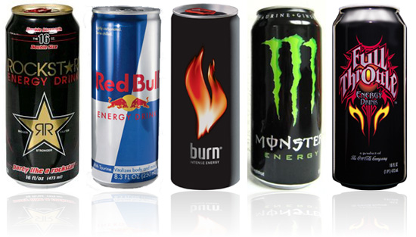
Energy Drinks
Term created by beverage companies
Limited research on safety and efficacy
Single serving usually = 72-150mg of caffeine
How many servings in typical can/bottle?
1g of guarana = 40mg of caffeine
Beware of added sugar
4g of sugar on food label = 1 tsp of white sugar
Empty calories!
Notes:
Black coffee, brewed: 133mg/8oz
Answer: 15-19 tsp of white sugar poured into that can (240-304 empty calories)
Source: http://anrcatalog.ucdavis.edu/pdf/8265.pdf
Definition: a beverage that contains caffeine in combination with other ingredients such as taurine, guarana, and B vitamins and claims to provide its consumers with extra energy.
Answer: typically 2-3 servings per bottle/can

Slide 23
Utilizing Your Resources At GAFB
Fitness Gyms (Mathis & Carswell)
FREE Classes!!!
Circuit (M-F @ Carswell)
Yoga (T,R,Sat) Carswell & Mathis
Zumba (M,W @ Mathis/T,R @ Carswell)
Power Abs (T,R @ Carswell)
Juijitsu (T,W @ Mathis)
Cycling (T,R @ Mathis)
FIP (PT Failures @ Mathis)/FAC Personal Training Sessions
Alpha Warrior Rig certification
Intermural Sports, 5Ks, Triathalon throughout the year
FREE Access to the McGarr Pool!!!

Slide 24
Utilizing Your Resources At GAFB
Health Promotions Programs……ALL FREE!!!
BodPod (by appt. only)
Running Clinic (by appt. only)
SAVOR Food Demo every 4th Tuesday
Sleep Hygiene Classes
Stress Management Classes
Health Challenges throughout the year
Contact Elizabeth Burmeister, Health Promotions Coordinator to set up an appointment

